Slide 1
Basic Database Terminology

Slide 2
Relational Schemas: Primary Key

Slide 3
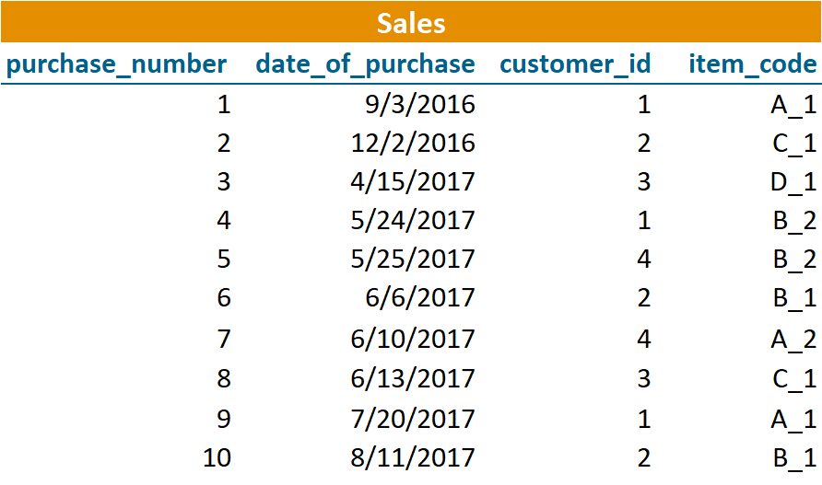
Relational Schemas: Primary Key

Slide 4
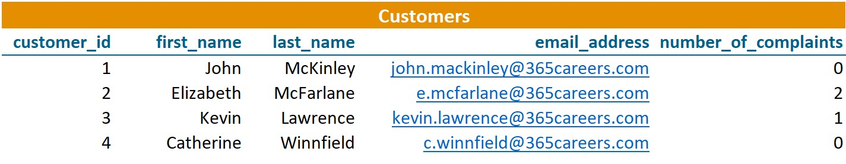
Relational Schemas: Primary Key

Slide 5
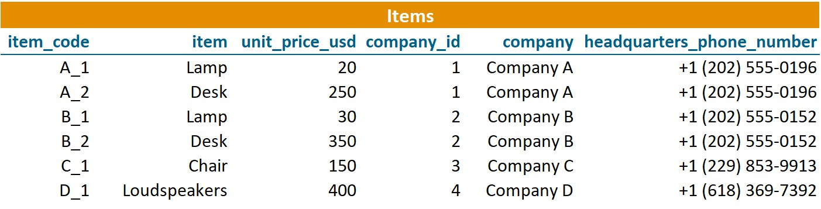
Relational Schemas: Primary Key

Slide 6
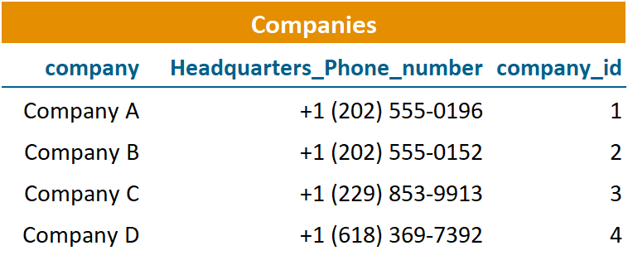
Relational Schemas: Primary Key

Slide 7

Relational Schemas: Primary Key
these tables have a tabular shape

Slide 8

Relational Schemas: Primary Key
these tables have a tabular form
a relational schema can be applied to represent them

Slide 9
Relational Schemas: Primary Key

Slide 10
Relational Schemas: Primary Key
sales per customer of our company

Slide 11
Relational Schemas: Primary Key

Slide 12
Relational Schemas: Primary Key

Slide 13
Relational Schemas: Primary Key

Slide 14
Relational Schemas: Primary Key

Slide 15
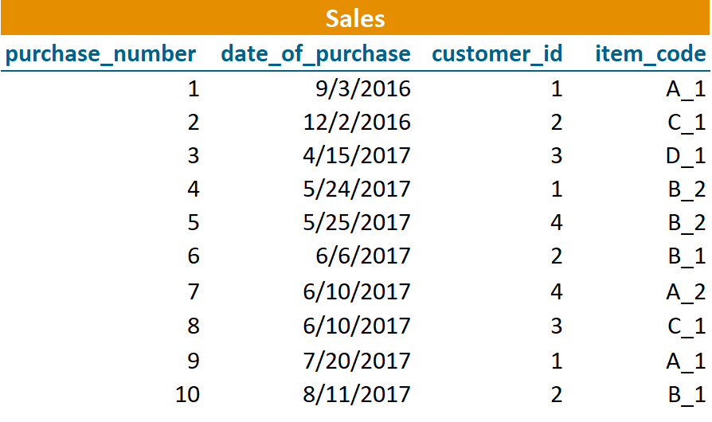
Relational Schemas: Primary Key
the dates of a few purchases may coincide

Slide 16
Relational Schemas: Primary Key
the ID of a customer may appear a few times

Slide 17
Relational Schemas: Primary Key
there is a possibility to see the same item code a few times

Slide 18
Relational Schemas: Primary Key

Slide 19
Relational Schemas: Primary Key
all the numbers in this column will be different

Slide 20

Relational Schemas: Primary Key
primary key
a column (or a set of columns) whose value exists and is unique for every record in a table is called a primary key

Slide 21
Relational Schemas: Primary Key
Primary Key

Slide 22
Relational Schemas: Primary Key
Primary Key
a column (or a set of columns) whose value exists and is unique for every record in a table is called a primary key

Slide 23
Relational Schemas: Primary Key
Primary Key
a column (or a set of columns) whose value exists and is unique for every record in a table is called a primary key
- each table can have one and only one primary key

Slide 24
Relational Schemas: Primary Key
Primary Key
a column (or a set of columns) whose value exists and is unique for every record in a table is called a primary key
each table can have one and only one primary key
in one table, you cannot have 3 or 4 primary keys

Slide 25
Relational Schemas: Primary Key
Primary Key
a column (or a set of columns) whose value exists and is unique for every record in a table is called a primary key
each table can have one and only one primary key
in one table, you cannot have 3 or 4 primary keys

Slide 26
Relational Schemas: Primary Key
Primary Key
may be composed of a set of columns

Slide 27
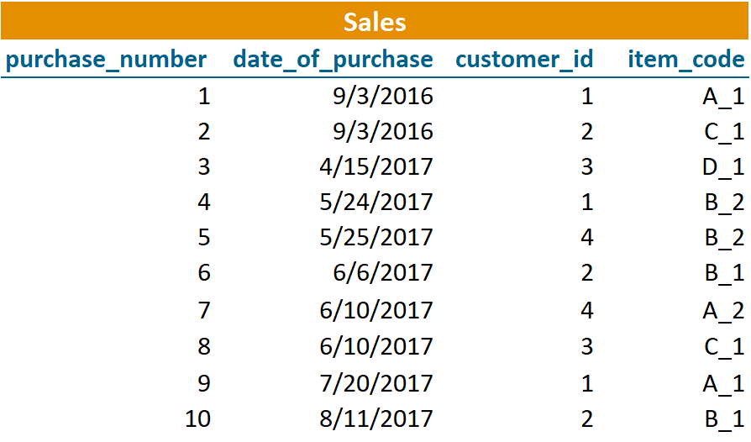
Relational Schemas: Primary Key
Primary Key
may be composed of a set of columns
e.g. “purchase_number” + “date_of_purchase”

Slide 28

Relational Schemas: Primary Key
Primary Key
may be composed of a set of columns
e.g. “purchase_number” + “date_of_purchase”

Slide 29
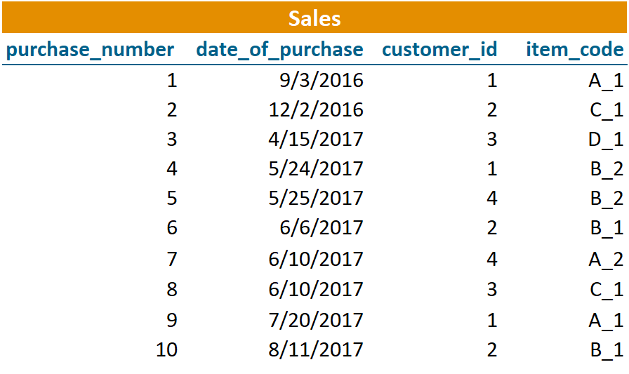
Relational Schemas: Primary Key
Primary Key
one-column primary key = all purchases will be recorded under a
different number

Slide 30
Relational Schemas: Primary Key
Primary Key
a column (or a set of columns) whose value exists and is unique for every record in a table is called a primary key
each table can have one and only one primary key
in one table, you cannot have 3 or 4 primary keys

Slide 31
Relational Schemas: Primary Key
Primary Key
a column (or a set of columns) whose value exists and is unique for every record in a table is called a primary key
each table can have one and only one primary key
in one table, you cannot have 3 or 4 primary keys
primary keys are the unique identifiers of a table

Slide 32
Relational Schemas: Primary Key
Primary Key
a column (or a set of columns) whose value exists and is unique for every record in a table is called a primary key
each table can have one and only one primary key
in one table, you cannot have 3 or 4 primary keys
primary keys are the unique identifiers of a table
cannot contain null values!

Slide 33
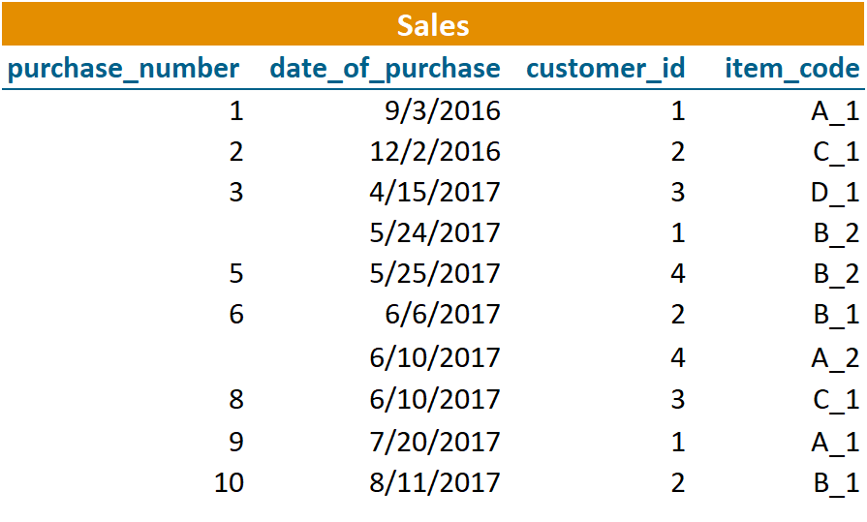
Relational Schemas: Primary Key
Primary Key

Slide 34
Relational Schemas: Primary Key
Primary Key

Slide 35


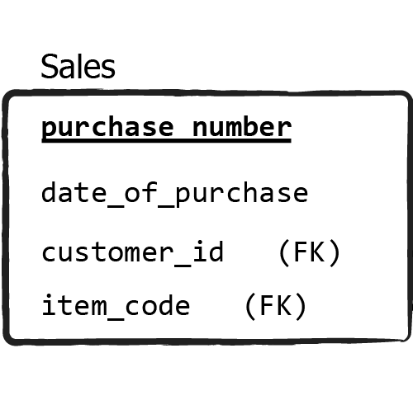
Relational Schemas: Primary Key

Slide 36
Relational Schemas: Primary Key
Table name: Primary key: Other fields:
Sales
purchase_number
date_of_purchase, customer_id, item_code

Slide 37
Relational Schemas: Primary Key
=

Slide 38
Relational Schemas: Primary Key
Primary Key
a column (or a set of columns) whose value exists and is unique for every record in a table is called a primary key
each table can have one and only one primary key
in one table, you cannot have 3 or 4 primary keys
primary keys are the unique identifiers of a table
cannot contain null values!

Slide 39
Relational Schemas: Primary Key
Primary Key
a column (or a set of columns) whose value exists and is unique for every record in a table is called a primary key
each table can have one and only one primary key
in one table, you cannot have 3 or 4 primary keys
primary keys are the unique identifiers of a table
cannot contain null values!
not all tables you work with will have a primary key

Slide 40
Relational Schemas: Primary Key
relational schema

Slide 41
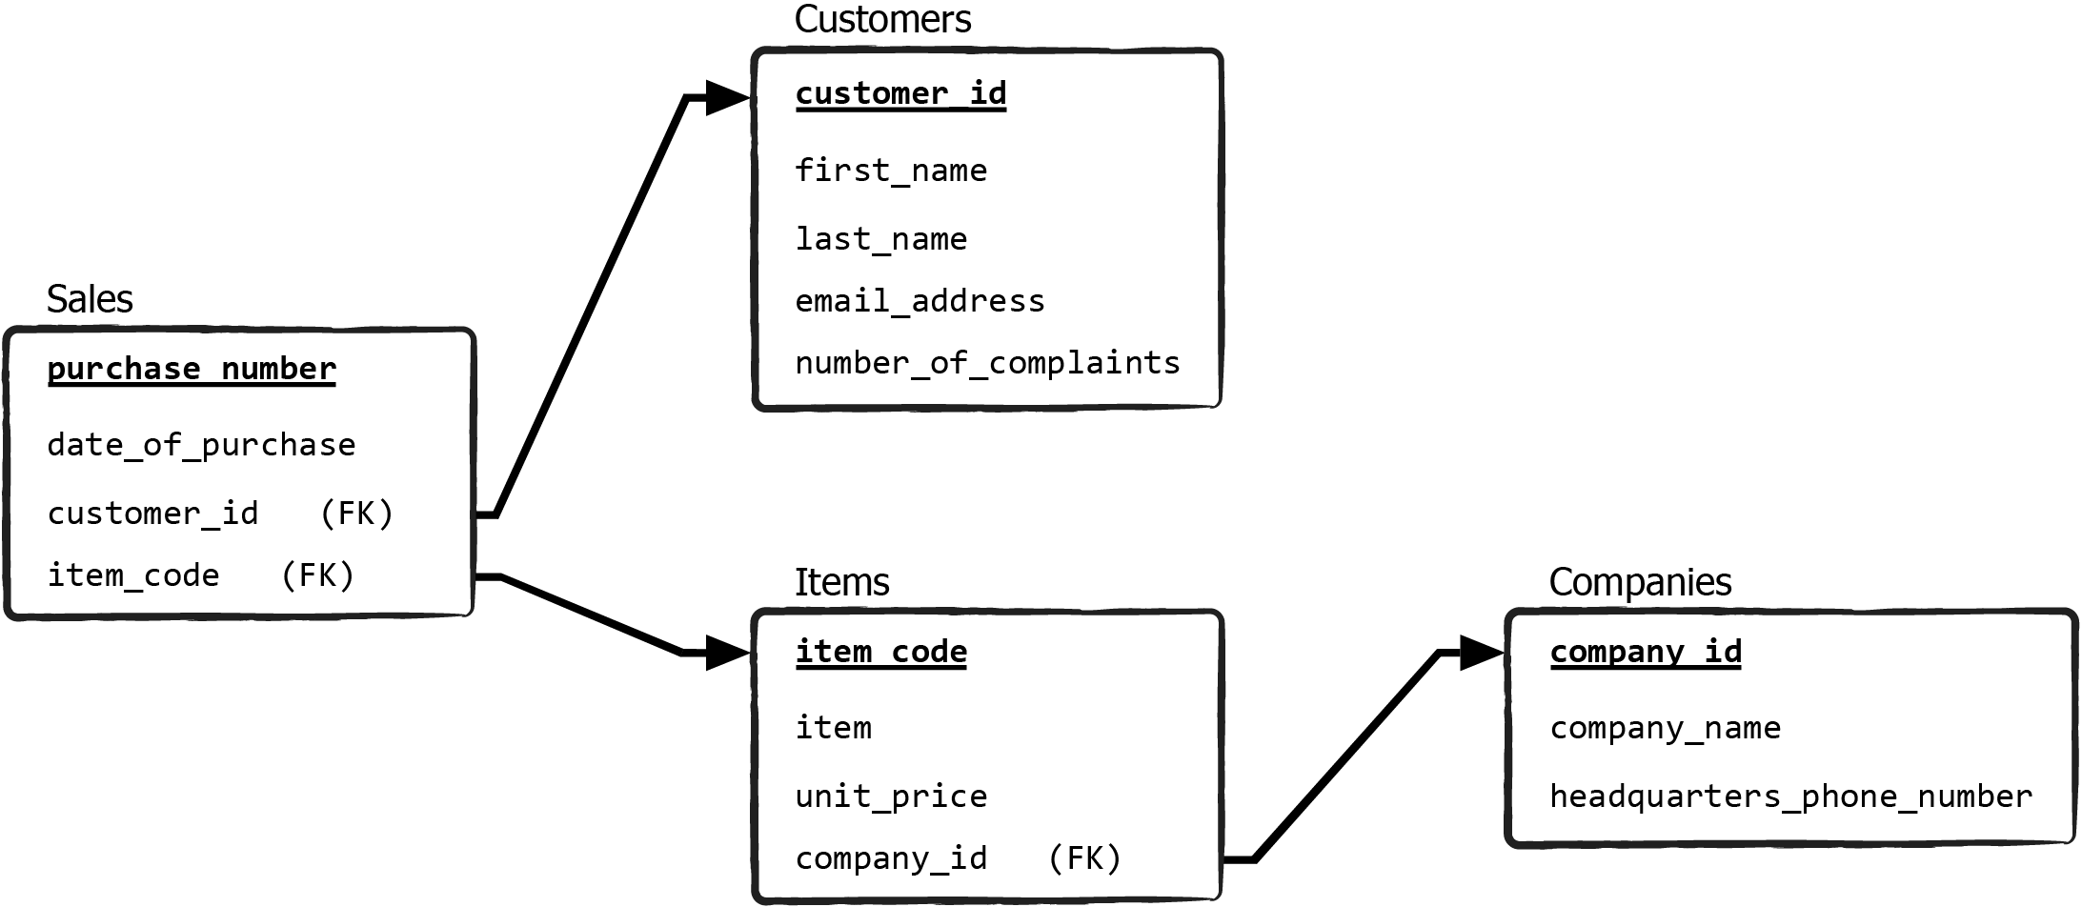
Relational Schemas: Primary Key
database schema

Slide 42
Relational Schemas: Primary Key
database schema (relational schemas)

